Slide 1
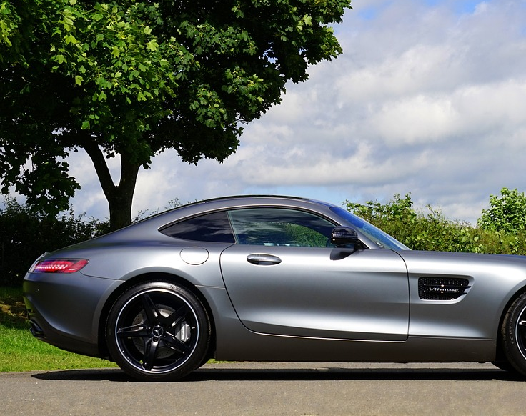
Mercedes A Legacy of Luxury
Exploring the Iconic Automotive Brand

Slide 2
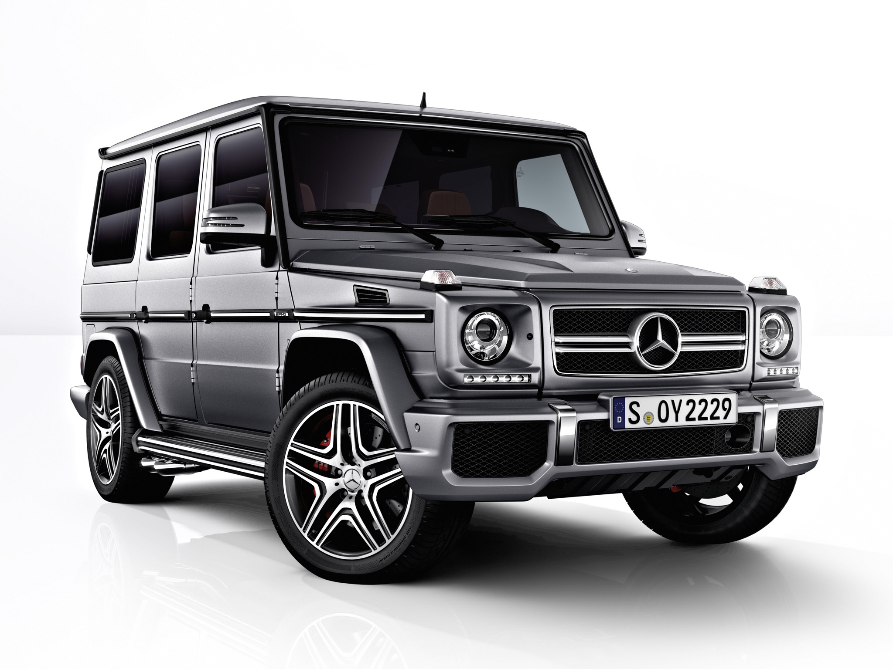
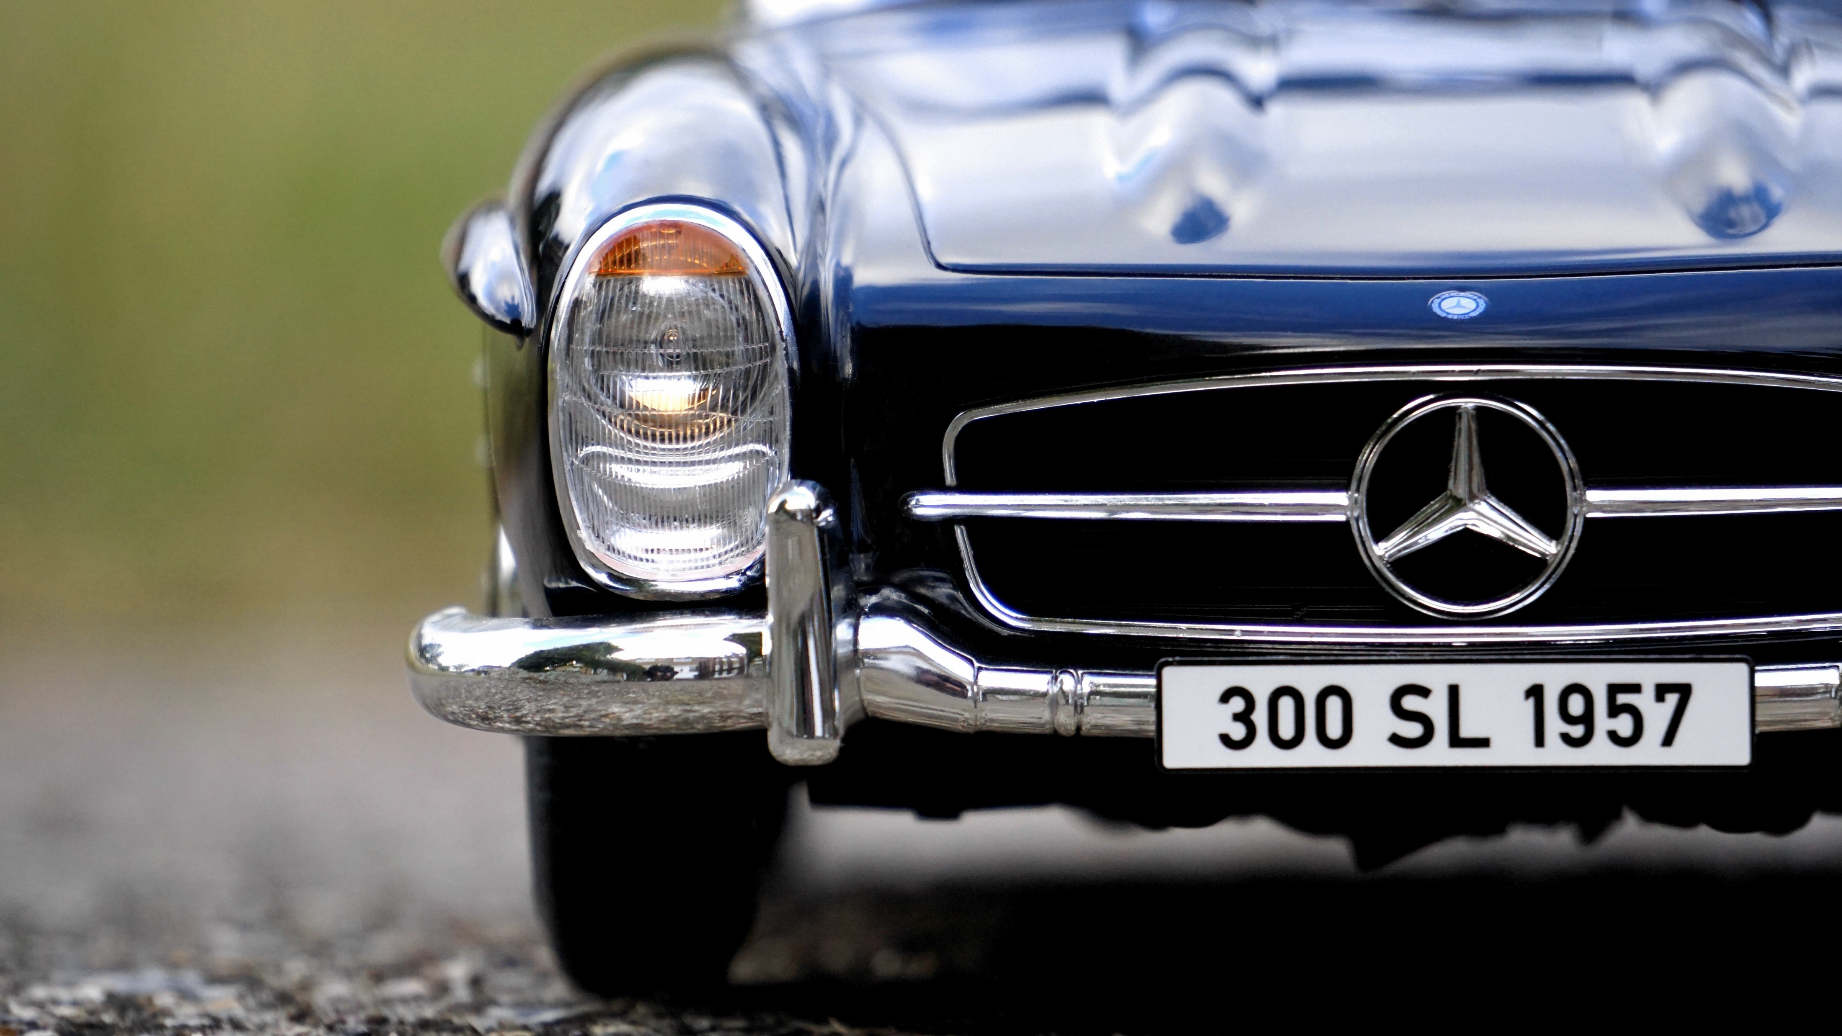

Mercedes
Home
History of Mercedes
Inventory
Reviews
Appointment
This Photo by Unknown Author is licensed under CC BY-SA

Slide 3
How it all Began 1834: Gottlieb Daimler.
It’s not the idea, it’s the implementation that counts.'
Gottlieb Daimler is born on 17 March 1834 in Schorndorf. After training as a gunsmith and working in France, he attends the Polytechnic School in Stuttgart from 1857 to 1859. After completing various technical activities in France and England, he starts work as a draftsman in Geislingen in 1862. At the end of 1863, he is appointed workshop inspector in a machine tool factory in Reutlingen, where he meets Wilhelm Maybach in 1865. In 1872, he becomes Technical Director of the gas engine manufacturer Deutz Gasmotorenfabrik, where he becomes familiar with Otto’s four-stroke technology. After differences with the Managing Director, he leaves the company in 1882. Daimler sets up a development workshop in his greenhouse at his Cannstatt villa to concentrate on developing petrol-driven four-stroke engines. Working with Wilhelm Maybach in 1884, he develops an internal combustion engine known today as the 'Grandfather Clock'. With its compact, low-weight design, the machine forms the basis for installation in a vehicle. The costs of trial operations soon consume Daimler’s entire fortune, however, so he is obliged to find business partners. He founds 'Daimler-Motoren-Gesellschaft' on 28 November 1890 together with Max Duttenhofer and his business partner Wilhelm Lorenz. But while Duttenhofer wants to produce stationary engines, Daimler prefers to focus on vehicle production, and a dispute ensues.
After Wilhelm Maybach resigns in 1891 due to unacceptable terms of

Slide 4

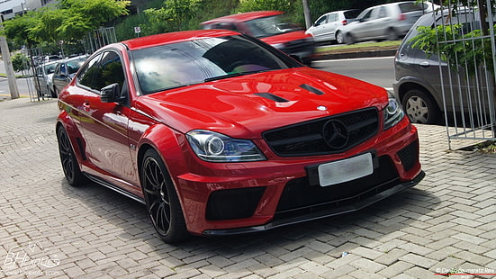
Pick Your Mercedes
At Mercedes we love your customers to leave with their dream car. This page will be dedicated to Building your own car to the way you want to cruise around in.

Slide 5

Mercedes Home is your home
We hope you have enjoyed your visit to Mercedes Benz dealership.
Please Leave us a review to know what we can improve on for the future.
Thank you
This Photo by Unknown Author is licensed under CC BY-SA

Slide 6

Set a Time to come pick up your new ride
By Setting up an appointment with Mercedes Benz it is faster and easier to have you up and going on four wheels.
This Photo by Unknown Author is licensed under CC BY-NC-ND

